Slide 1
Group 2
Krysta Valenzia, Druv Narain, Max Moore, Ola Ajala, Angina Shrestha, Caitlin nanashko, Kenny vu

Slide 2
Team Members Roles and Responsibilities
Krysta Valenzia – Coordinator, Requirements, HLA Diagram, Meetings/Updates from Professor
HTML/CSS Programmer
Druv Narain – Documenter, Use Cases, Requirements, Diagrams (HLA, Sequence, Class and Interface), Task List
Java Programmer
Max Moore – Created Repository
Java Programmer, Snapchat API
Ola Ajala – Use Cases, Requirements, Login Template
Game Programmer
Angina Shrestha – Use Cases, Requirements
HTML/CSS Programmer
Caitlin Nanashko – Use Cases, Requirements
Game License, Database Design
Kenny Vu – Use Cases, Class Diagram
Game Programmer

Slide 3
Summary of Weekly Deliverables (so far)

Slide 4
4 Available Snapchat APIs to developers
1. Login API
This will allow people to use their Snapchat username to create accounts on other apps, similar to how you can login to Spotify with Facebook. This could allow your business's website to build in a Snapchat login along with a regular user login.
2. Camera API
This will let people share things from other apps directly to their Snapchat Story, potentially giving businesses the chance to spread their content further or engage in cross-promotional marketing across platforms and apps.

Slide 5
3. Bitmoji integration
Another API will let users transfer their Bitmoji avatar into other apps. With the popularity of Bitmoji among consumers, this could make your company's app more accessible and fun for users.
4. Themed stories
This API will allow developers to use public Snapchat photos and videos to create themed Stories on a third-party app or website, Recode reported, which could allow users to better engage with your company's site.
In conclusion, regarding privacy, Snapchat's APIs offer limited information to developers. For example, the login API only gives them access to a user's Snapchat username, and leaves out other demographic information like age or location, Recode reported.
More so, Snapchat executives also said that the company plans to manually review all API partners. "Any future third-party Snap Kit app integration submitted to us will need to go through a review and approval process to make sure we know how their integration will work," a company spokesperson told Recode.

Slide 6


Game Specs
Web Browser Based
Integrate exam questions with the game
Social Media: Trying to find Snapchat API
Possibly Unity game
Javascript based game as backup

Slide 7
Group Collaboration
GroupMe
GoogleDocs
Github
Weekly Meetings (online and in person)

Slide 8

Challenges Faced
EVERYTHING
Learning web architecture
Integrating multiple programming languages
Creating Repositories

Slide 9
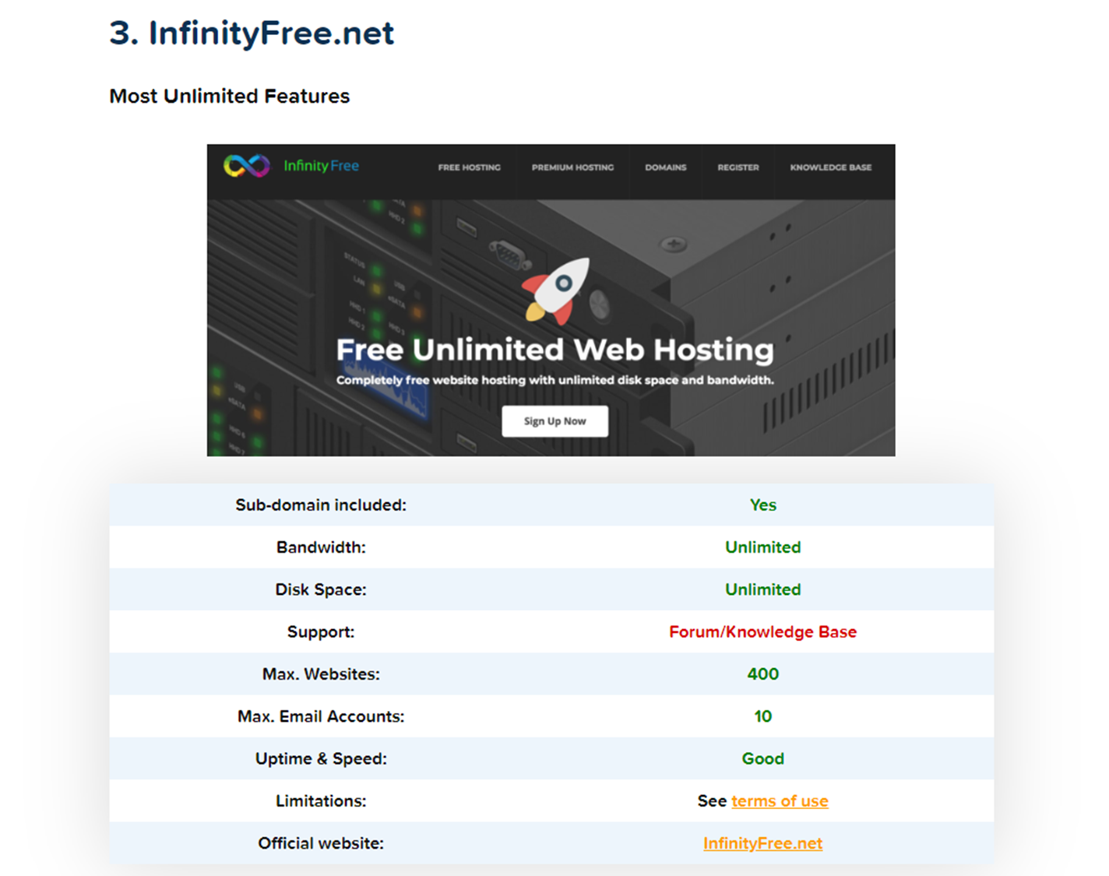
Web Host
Pros:
Free SSL certificate with all plans
No front-end ads
Free CloudFlare CDN
10 email accounts
1 FTP account
Unlimited bandwidth and storage space
400 MySQL databases.
Cons:
What does unlimited mean?
The penalty for non-compliance with the limitations on their “unlimited” offer is the suspension or elimination of your website and data.

Slide 10
Back up Web Host - Hostinger.com
Pros:
1 MySQL database
1 FTP user
Access to their website builder
One-click install of WordPress or other CMS
A free domain name for 1 year
24/7 customer support (seriously, it’s one of the best)
100GB of Bandwidth and 10GB of Disk Space
One free email account
Cons:
Their user interface doesn’t give you access to a classic cPanel

Slide 11
Overview of Technologies
WordPress – has built in solutions, will build database, has several API’s, still customizable
Javascript – widely used and supported in web development
HTML/CSS – front-end language of the web
GitHub – simple user experience, some group members already familiar, share code easily and revert back if mistakes are made

Slide 12

Moving Forward
Building code
Developing Skeleton for Testing
Planning Code Review Process
Learning new technologies (HTML, REST API)
WebEx10 Host
Exam Questions

